Slide 1
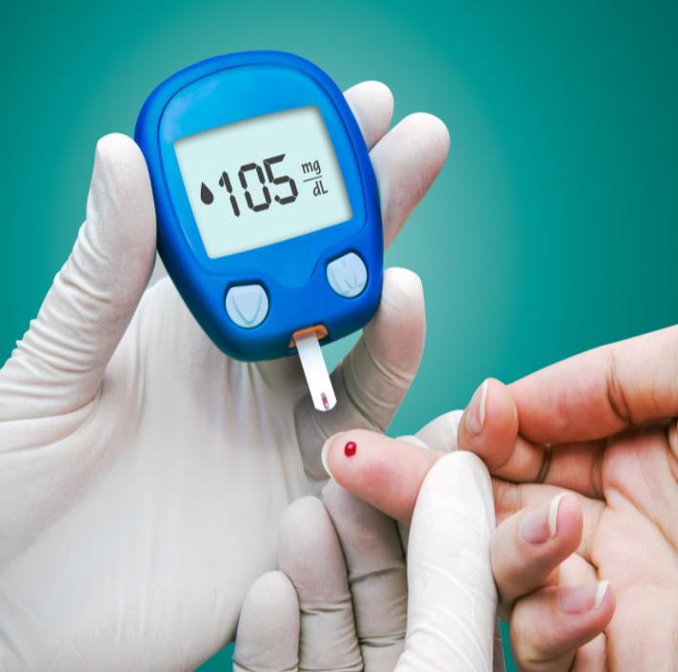

Project Report On Healthcare
Submitted by
Debatri Roy
PGP DS MAR 2021 cohort 1

Slide 2
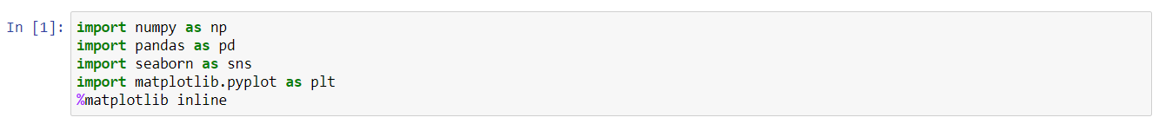
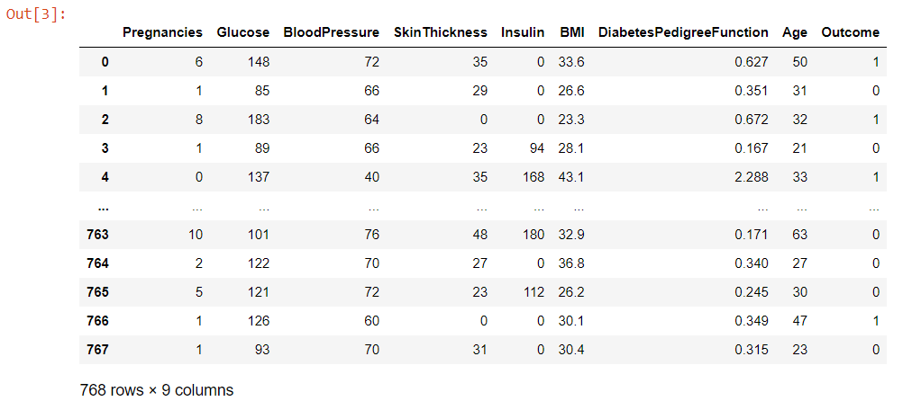
Python execution O/P Screenshots and Interpretation
Including library functions of packages
Load the Dataset
Print the Dataset
The above output shows the dataset. We can see that the dataset contains 768 rows and 9 columns.

Slide 3
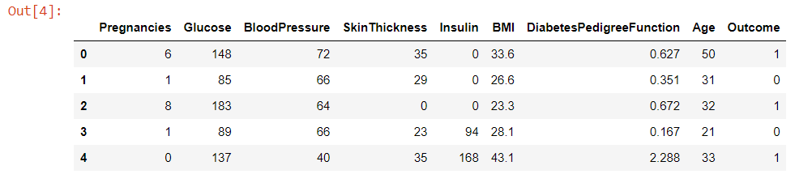
Python execution O/P Screenshots and Interpretation
Print first few rows of the data dataframe
The head() displays the first 5 rows of the data dataset.

Slide 4
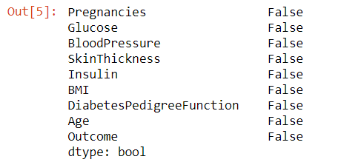
Python execution O/P Screenshots and Interpretation
Data Exploration
Checking for Null Values
From the outputs of the above cell we can see that there are no null values or missing values in the dataset.

Slide 5
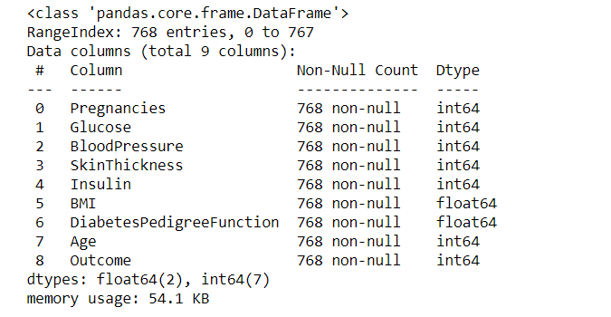
Python execution O/P Screenshots and Interpretation
Checking the information
The info() displays the information about the dataset.

Slide 6
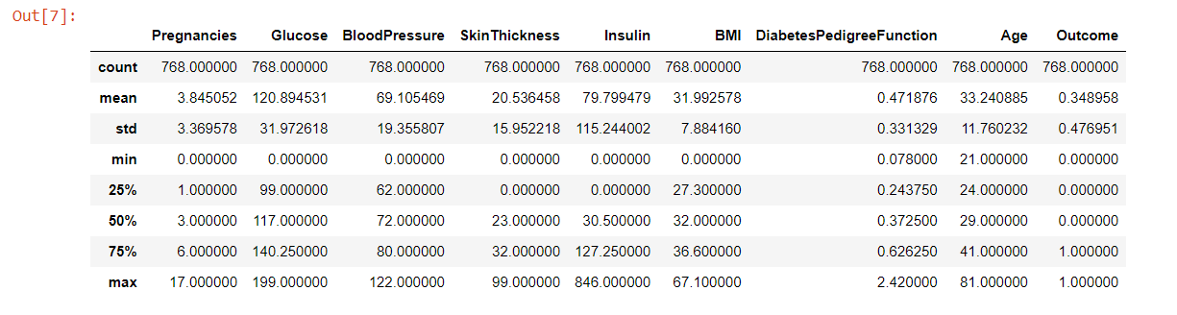
Python execution O/P Screenshots and Interpretation
Describing the Data frame
The describe() shows some basic statistical details like count, mean, median, standard deviation, quartile values, percentile, minimum and maximum values of each attributes of the dataset.

Slide 7
Python execution O/P Screenshots and Interpretation
Insights from Descriptive Analysis
There is 768 observations of 9 variable. Independent variables are:
Pregnencies
Glucose
BloodPressure
Insulin
BMI and
DiabetesPedigree Function.
Age is Outcome Variable. Average Age of Patients are 33.24 with minimum being 21 and maximum 81.
Avg. value of independent variables are:
Pregnencies = 3.845052
Glucose = 120.894531
Blood Pressure = 69.105469
Skin Thickness=20.536458
Insulin = 79.799479
BMI = 31.992578
Diabetes Pedigree Function = 0.471876

Slide 8
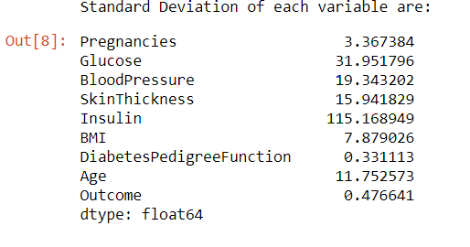
Python execution O/P Screenshots and Interpretation
Standard deviation of variables
The above output displays the Standard Deviation of each variables in the dataset.

Slide 9
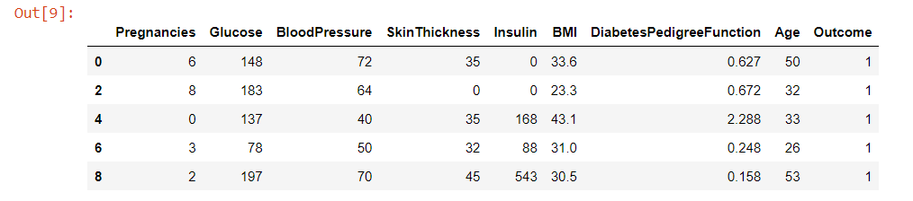
Python execution O/P Screenshots and Interpretation
Filter the positive outcome values and print the first few columns with positive outcome
The ‘Positive’ outcomes are filtered and then the first few columns of the dataset with ‘Positive’ outcome is printed.

Slide 10
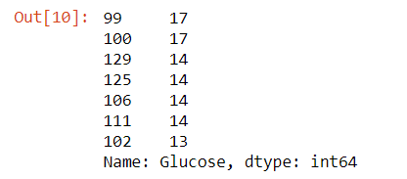
Python execution O/P Screenshots and Interpretation
Counting the number of heads of particular Glucose value and Print first few rows
The value_count() counts the number of heads of a particular ‘Glucose’ value and then the head(7) displays the top 7 Glucose values and their corresponding counting in the dataset.

Slide 11
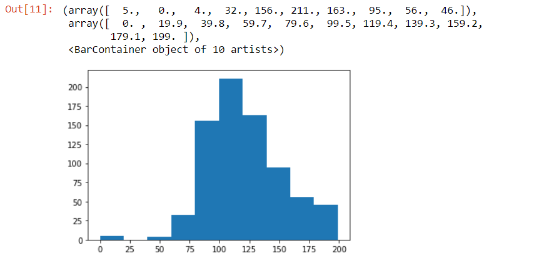
Python execution O/P Screenshots and Interpretation
Plot the Histogram for Glucose values
The above output shows the histogram for ‘Glucose’ values.

Slide 12
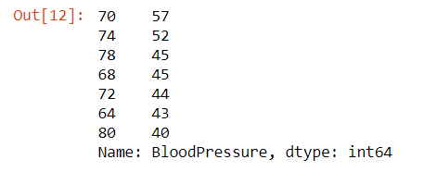
Python execution O/P Screenshots and Interpretation
Counting the number of heads of particular Blood Pressure value and Print first few rows
The value_count() counts the number of heads of a particular ‘Blood Pressure’ value and then the head(7) displays the top 7 Blood Pressure values and their corresponding counting in the dataset.

Slide 13
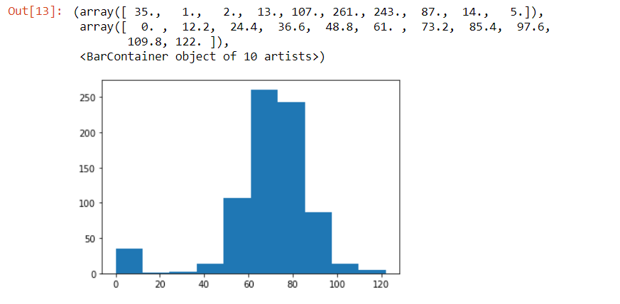
Python execution O/P Screenshots and Interpretation
Plot the Histogram for Blood Pressure values
The above output shows the histogram for ‘Blood Pressure’ values.

Slide 14
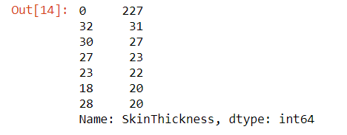
Python execution O/P Screenshots and Interpretation
Counting the number of heads of particular Skin Thickness value and Print first few rows
The value_count() counts the number of heads of a particular ‘Skin Thickness’ value and then the head(7) displays the top 7 Skin Thickness values and their corresponding counting in the dataset.

Slide 15
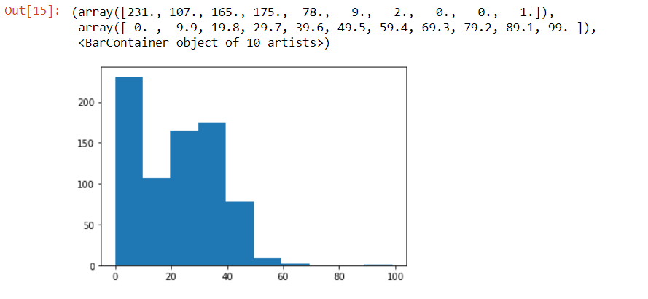
Python execution O/P Screenshots and Interpretation
Plot the Histogram for Skin Thickness values
The above output shows the histogram for ‘Skin Thickness’ values.

Slide 16
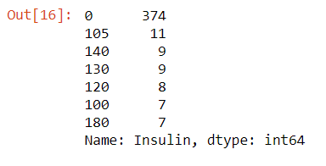
Python execution O/P Screenshots and Interpretation
Counting the number of heads of particular Insulin value and Print first few rows
The value_count() counts the number of heads of a particular ‘Insulin’ value and then the head(7) displays the top 7 insulin values and their corresponding counting in the dataset.

Slide 17
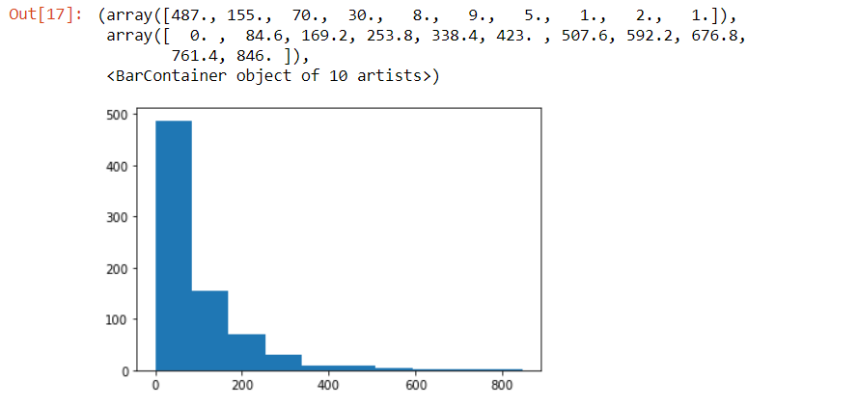
Python execution O/P Screenshots and Interpretation
Plot the Histogram for Insulin values
The above output shows the histogram for ‘Insulin’ values.

Slide 18
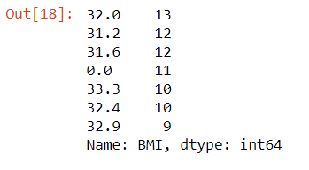
Python execution O/P Screenshots and Interpretation
Counting the number of heads of particular BMI value and Print first few rows
The value_count() counts the number of heads of a particular ‘BMI’ value and then the head(7) displays the top 7 BMI values and their corresponding counting in the dataset.

Slide 19
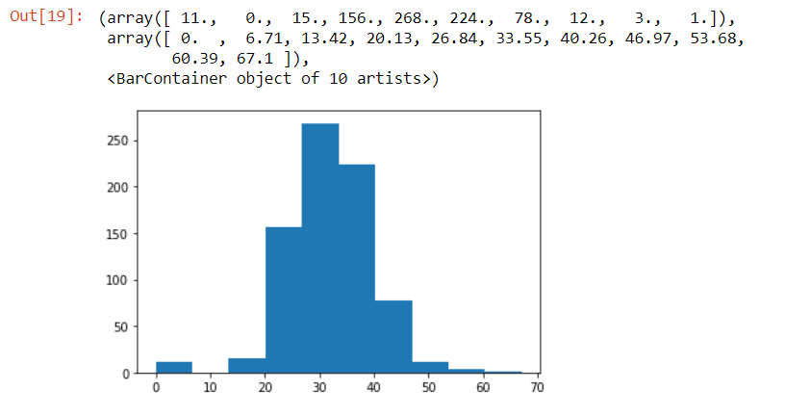
Python execution O/P Screenshots and Interpretation
Plot the Histogram for BMI values
The above output shows the histogram for ‘BMI’ values.

Slide 20
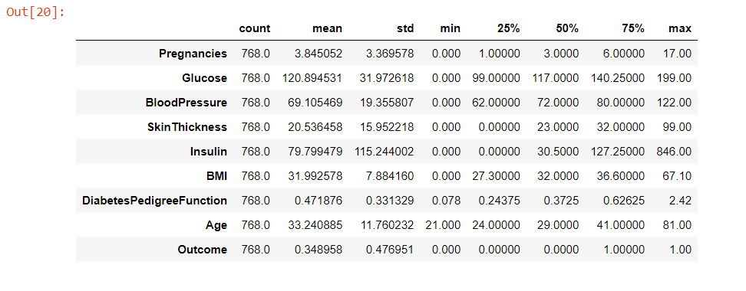
Python execution O/P Screenshots and Interpretation
Describe and then Transpose the Data Frame
The describe() shows some basic statistical details like count, mean, median, standard deviation, quartile values, percentile, minimum and maximum values of each attributes of the dataset. The transpose() transpose the rows to columns and columns to rows.

Slide 21
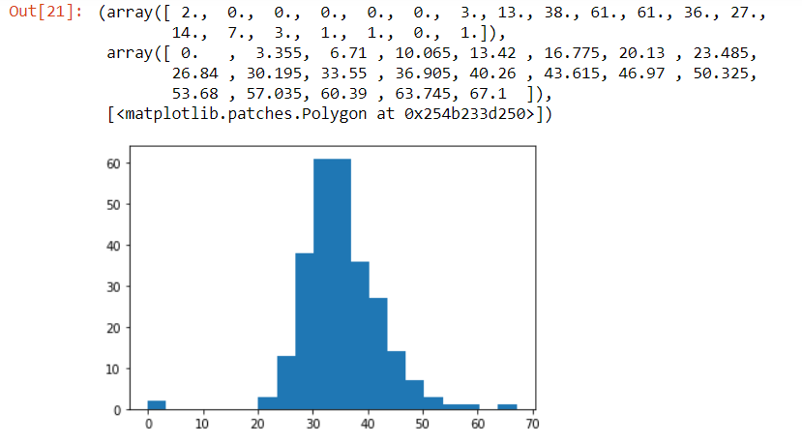
Python execution O/P Screenshots and Interpretation
Plot the Histogram for Positive BMI values
The above output shows the histogram for positive BMI values. Histtype 'stepfilled' generates a lineplot that is by default filled. Bins defines the number of equal-width bins in the range.

Slide 22
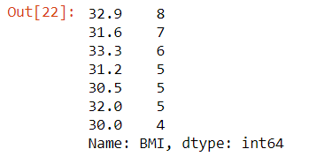
Python execution O/P Screenshots and Interpretation
Counting the number of heads of particular Positive BMI value and Print first few rows
The value_count() counts the number of heads of a particular positive ‘BMI’ value and then the head(7) displays the top 7 positive BMI values and their corresponding counting in the dataset.

Slide 23
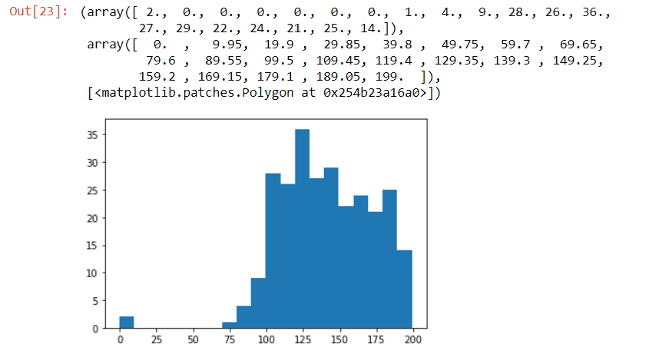
Python execution O/P Screenshots and Interpretation
Plot the Histogram for Positive Glucose values
The above output shows the histogram for positive Glucose values. Histtype 'stepfilled' generates a lineplot that is by default filled. Bins defines the number of equal-width bins in the range.

Slide 24
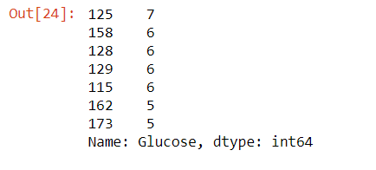
Python execution O/P Screenshots and Interpretation
Counting the number of heads of particular Positive Glucose value and Print first few rows
The value_count() counts the number of heads of a particular positive ‘Glucose’ value and then the head(7) displays the top 7 positive Glucose values and their corresponding counting in the dataset.

Slide 25
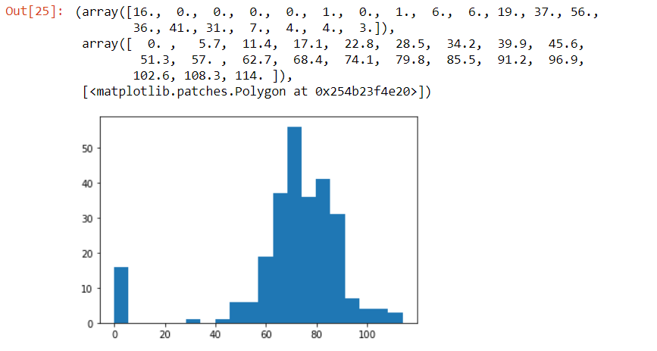
Python execution O/P Screenshots and Interpretation
Plot the Histogram for Positive Blood Pressure values
The above output shows the histogram for positive Blood Pressure values. Histtype 'stepfilled' generates a lineplot that is by default filled. Bins defines the number of equal-width bins in the range.

Slide 26
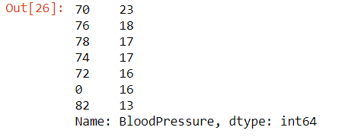
Python execution O/P Screenshots and Interpretation
Counting the number of heads of particular Positive Blood Pressure value and Print first few rows
The value_count() counts the number of heads of a particular positive ‘Blood Pressure’ value and then the head(7) displays the top 7 positive Blood Pressure values and their corresponding counting in the dataset.

Slide 27
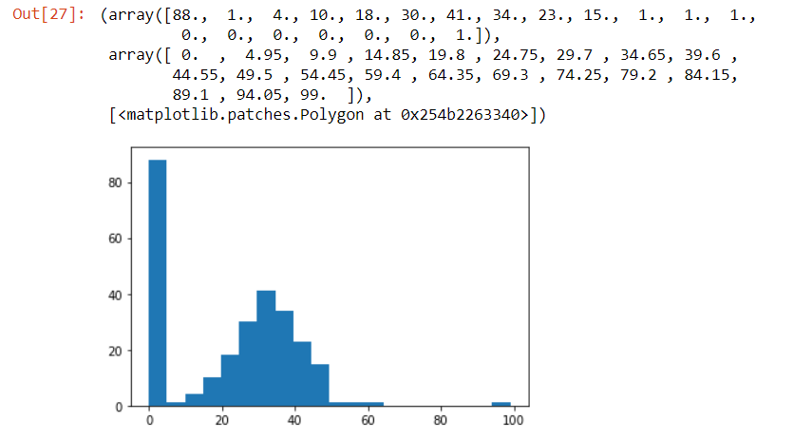
Python execution O/P Screenshots and Interpretation
Plot the Histogram for Positive Skin Thickness values
The above output shows the histogram for positive Skin Thickness values. Histtype 'stepfilled' generates a lineplot that is by default filled. Bins defines the number of equal-width bins in the range.

Slide 28
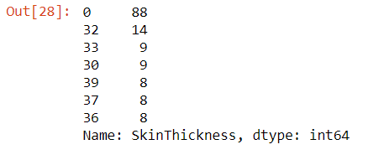
Python execution O/P Screenshots and Interpretation
Counting the number of heads of particular Positive Skin Thickness value and Print first few rows
The value_count() counts the number of heads of a particular positive ‘Skin Thickness’ value and then the head(7) displays the top 7 positive Skin Thickness values and their corresponding counting in the dataset.

Slide 29
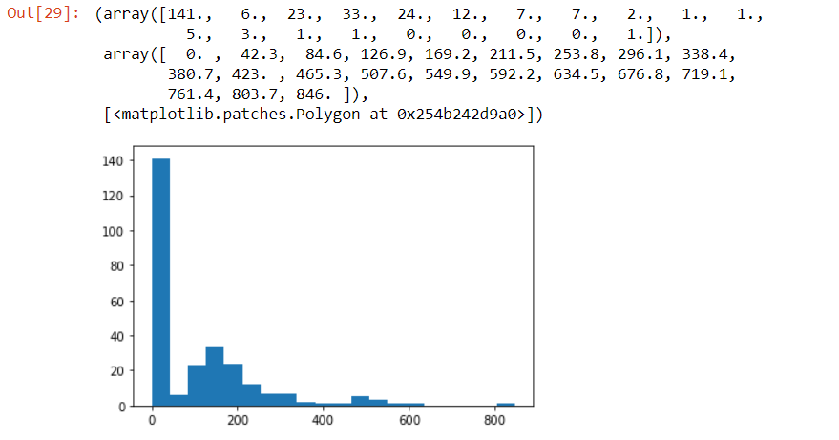
Python execution O/P Screenshots and Interpretation
Plot the Histogram for Positive Insulin values
The above output shows the histogram for positive Insulin values. Histtype 'stepfilled' generates a lineplot that is by default filled. Bins defines the number of equal-width bins in the range.

Slide 30
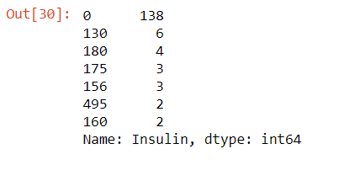
Python execution O/P Screenshots and Interpretation
Counting the number of heads of particular Positive Insulin value and Print first few rows
The value_count() counts the number of heads of a particular positive ‘Insulin’ value and then the head(7) displays the top 7 positive Insulin values and their corresponding counting in the dataset.

Slide 31
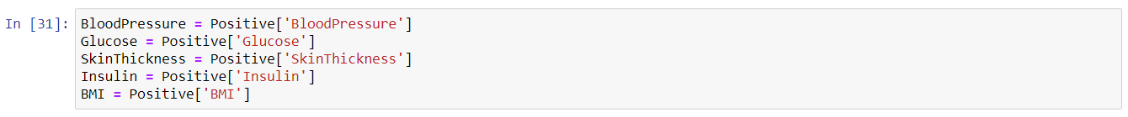
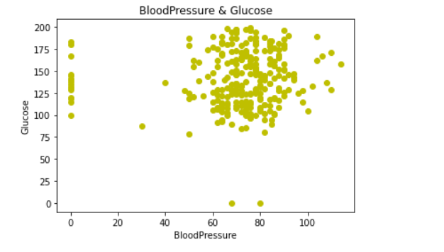
Python execution O/P Screenshots and Interpretation
Scatter Plot
Assigning the Positive values of the variables
Plotting Scatter Plot of Blood Pressure & Glucose
Here the scatterplot is plotted by placing Blood Pressure at x-axis and Glucose at y-axis.

Slide 32
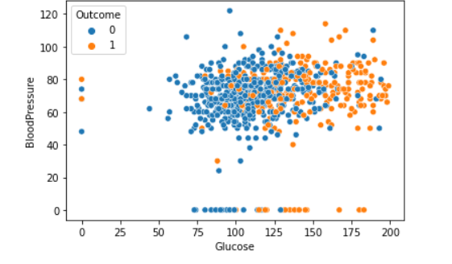
Python execution O/P Screenshots and Interpretation
Plotting Scatter Plot of Glucose & Blood Pressure
Here the scatterplot is plotted by placing Glucose (independent variable) at x-axis and Blood Pressure (dependent variable) at y-axis. Hue is grouping variable that will produce points with different colours. Data is input data structure.

Slide 33
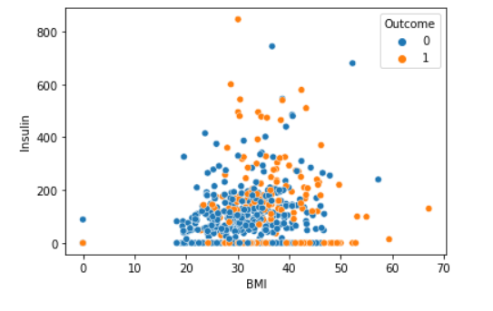
Python execution O/P Screenshots and Interpretation
Plotting Scatter Plot of BMI & Insulin
Here the scatterplot is plotted by placing BMI (independent variable) at x-axis and Insulin (dependent variable) at y-axis. Hue is grouping variable that will produce points with different colours. Data is input data structure.

Slide 34
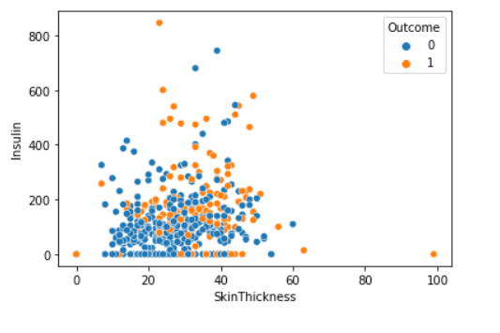
Python execution O/P Screenshots and Interpretation
Plotting Scatter Plot of Skin Thickness & Insulin
Here the scatterplot is plotted by placing Skin Thickness (independent variable) at x-axis and Insulin (dependent variable) at y-axis. Hue is grouping variable that will produce points with different colours. Data is input data structure.

Slide 35
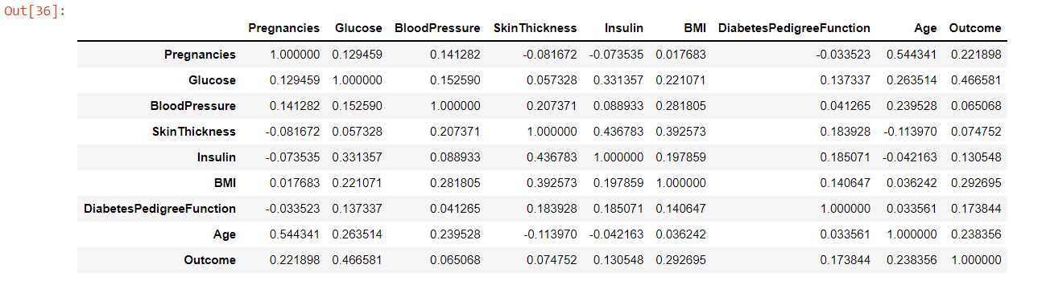
Python execution O/P Screenshots and Interpretation
Correlation Matrix
The above output showing correlation matrix of data dataset.

Slide 36
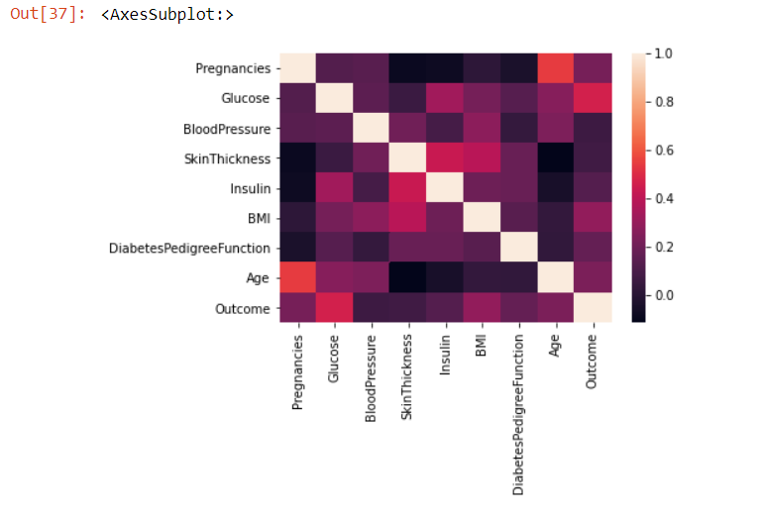
Python execution O/P Screenshots and Interpretation
Correlation Heat Map
The above output showing correlation heat map of data dataset.

Slide 37

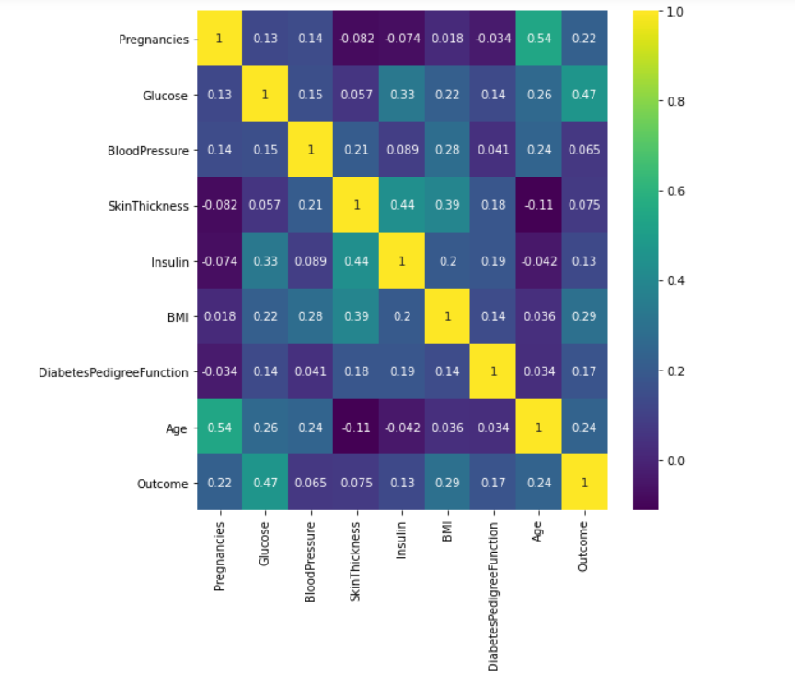
Python execution O/P Screenshots and Interpretation
Getting Correlation Values with cmap set to viridis
The above output showing correlation values of data dataset while cmap is set to viridis.

Slide 38
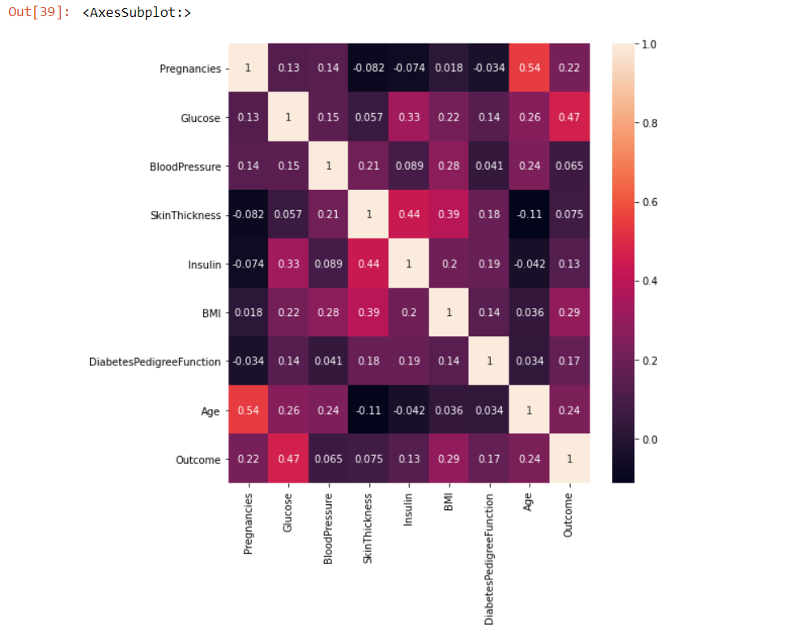
Python execution O/P Screenshots and Interpretation
Getting Correlation Values
The above output showing correlation values of data dataset.

Slide 39
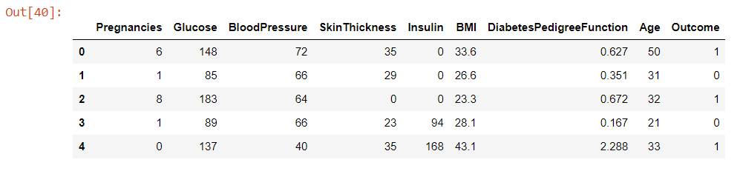
Python execution O/P Screenshots and Interpretation
Data Modeling
Logistic Regression and Model Building
Print first few rows of the data dataframe
The head() displays the first 5 rows of the data dataset.

Slide 40

Python execution O/P Screenshots and Interpretation
Assigning Values to features and label
Split the dataset into Train and Test set
Creating Logistic Regression model
In the above cells, I assigned values to features and label. Then I split the dataset into Train and Test set. I have created Logistic Regression model.

Slide 41


Python execution O/P Screenshots and Interpretation
Printing Train and Test Score
The Train score is 0.7719869706840391 and Test score is 0.7662337662337663.
Getting Confusion matrix
The above output prints the Confusion matrix.

Slide 42
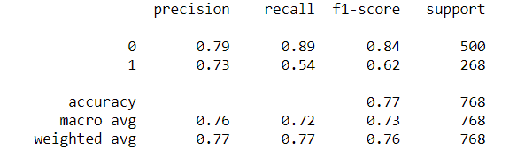
Python execution O/P Screenshots and Interpretation
Getting Classification Report
The above output prints the Classification report.

Slide 43
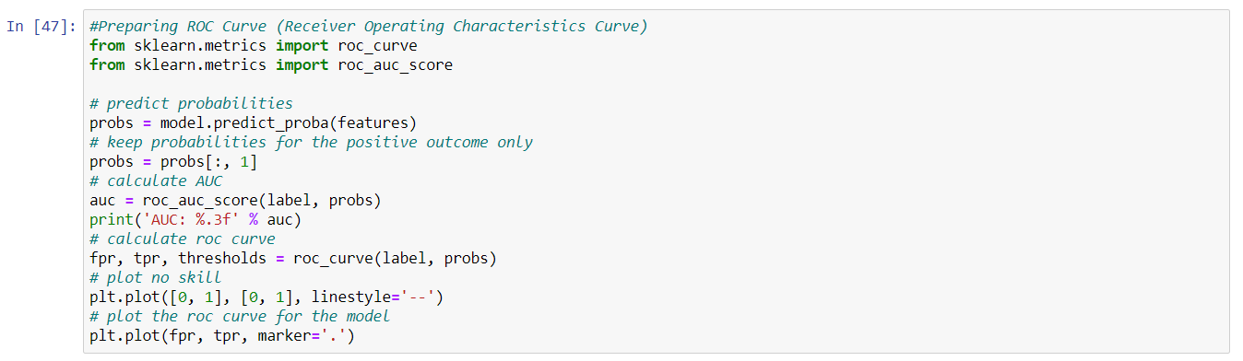
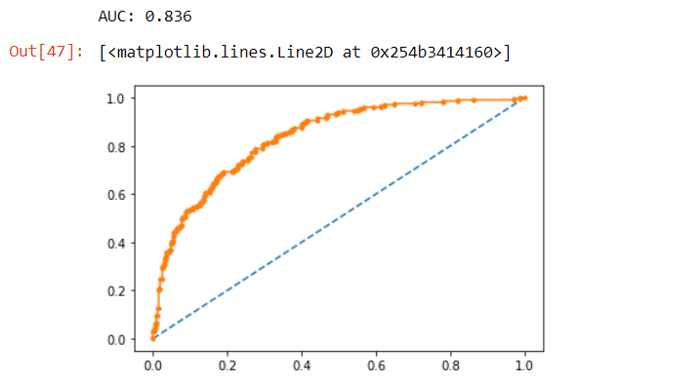
Python execution O/P Screenshots and Interpretation
Preparing ROC Curve
The AUC value is 0.836 and the ROC i.e. Receiver Operating Characteristics Curve is plotted here.

Slide 44

Python execution O/P Screenshots and Interpretation
Applying Decision Tree Classifier
In the above cell, I have applied Decision Tree Classifier to create a model with maximum depth 5.
Calculating Training Score of Decision Tree Classifier
The Training score of Decision Tree Classifier is 0.8289902280130294.

Slide 45

Python execution O/P Screenshots and Interpretation
Calculating Test Score of Decision Tree Classifier
The Test score of Decision Tree Classifier is 0.7597402597402597.
Applying Random Forest Classifier
In the above cell, I have applied Random Forest Classifier to create a model with n_estimator 11.

Slide 46


Python execution O/P Screenshots and Interpretation
Calculating Training Score of Random Forest Classifier
The Training score of Random Forest Classifier is 0.9853420195439739.
Calculating Test Score of Random Forest Classifier
The Test score of Random Forest Classifier is 0.7272727272727273.

Slide 47
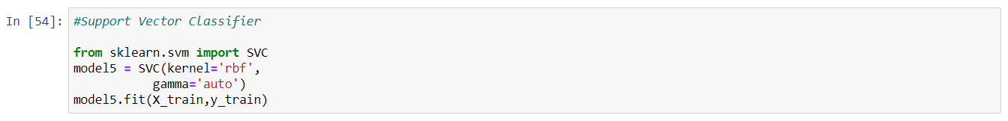


Python execution O/P Screenshots and Interpretation
Applying Support Vector Classifier
In the above cell, I have applied Support Vector Classifier to create a model with kernel set to ‘rbf’ and gamma set to ‘auto’.
Calculating Training Score of Support Vector Classifier
The Training score of Support Vector Classifier is 1.0.

Slide 48

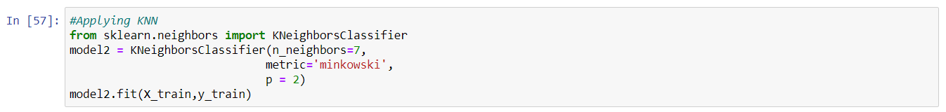
Python execution O/P Screenshots and Interpretation
Calculating Test Score of Support Vector Classifier
The Test score of Support Vector Classifier is 0.6168831168831169.
Applying KNN Classifier
In the above cell, I have applied KNN Classifier to create a model with n_neighbors = 7, metric set to ‘minkowski’ and p = 2.

Slide 49


Python execution O/P Screenshots and Interpretation
Calculating Training Score of KNN Classifier
The Training score of KNN Classifier is 0.8045602605863192.
Calculating Test Score of KNN Classifier
The Test score of KNN Classifier is 0.6948051948051948.

Slide 50
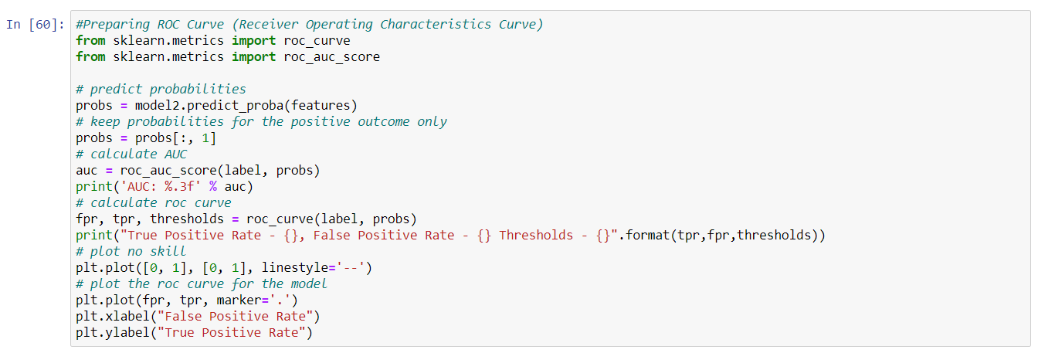
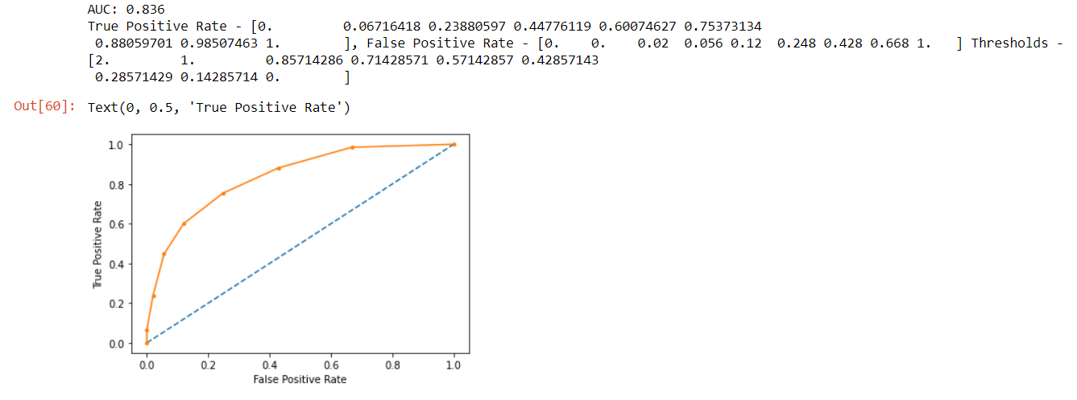
Python execution O/P Screenshots and Interpretation
Calculating & Preparing ROC Curve, Predicting Probability and Calculating AUC values
In the above cell:
The ROC curve is prepared.
The probability is calculated.
I kept the probabilities for only positive outcome.
The AUC value is 0.836.
The true positive rate is also printed.
Finally, the ROC curve is plotted.

Slide 51
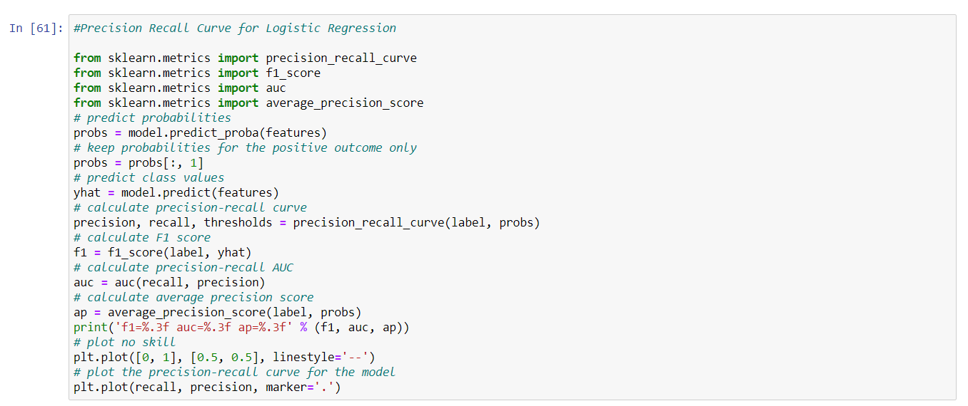
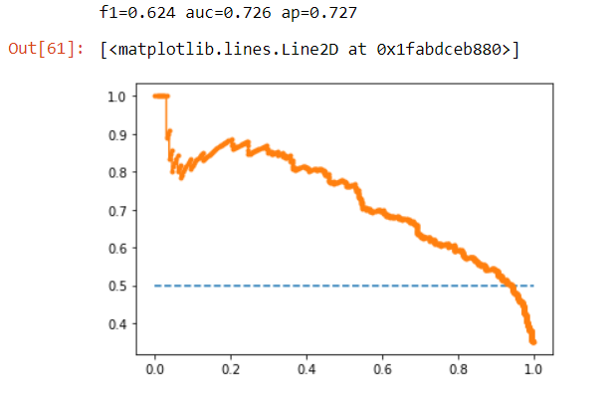
Python execution O/P Screenshots and Interpretation
Precision Recall Curve for Logistic Regression
For Logistic Regression:
The f1 score is 0.624.
The AUC is 0.726.
The average precision score, ‘ap’ value is 0.727.
The Precision Recall Curve is plotted.

Slide 52
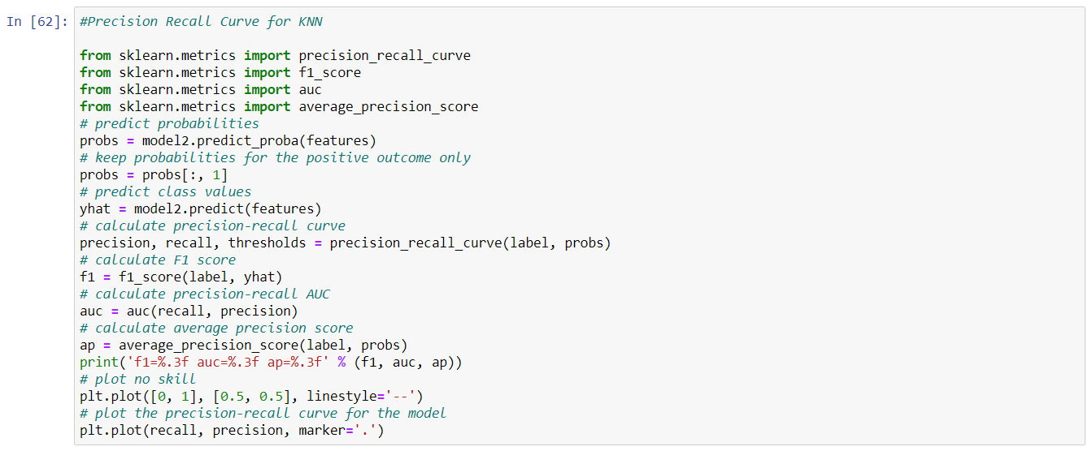

Python execution O/P Screenshots and Interpretation
Precision Recall Curve for KNN
For KNN:
The f1 score is 0.658.
The AUC is 0.752.
The average precision score, ‘ap’ value is 0.709.
The Precision Recall Curve is plotted.

Slide 53


Python execution O/P Screenshots and Interpretation
Precision Recall Curve for Decision Tree Classifier
For Decision Tree Classifier:
The f1 score is 0.708.
The AUC is 0.800.
The average precision score, ‘ap’ value is 0.761.
The Precision Recall Curve is plotted.

Slide 54


Python execution O/P Screenshots and Interpretation
Precision Recall Curve for Random Forest
For Random Forest Classifier:
The f1 score is 0.902.
The AUC is 0.960.
The average precision score, ‘ap’ value is 0.951.
The Precision Recall Curve is plotted.

Slide 55

Python execution O/P Screenshots and Interpretation
Data Reporting using Tableau

